Slide 1
General Models of Combinatorial Optimization
Shaowei Cai, UCAS, 2020

Slide 2
Combinatorial Optimization
Combinatorial optimization problems: optimization problems where the variables are discrete.
Combinatorial problems…
involve finding a solution (can be subset, ordering, or assignment etc.) for a set of discrete objects which satisfies certain constraints
arise in many domains of computer science and various application areas
Combinatorial problems
Combinatorial decision problems
Combinatorial optimization problems
The decision and optimization versions of the same combinatorial problem can be easily transfered to each other. Combinatorial optimization is more often mentioned and studied.

Slide 3
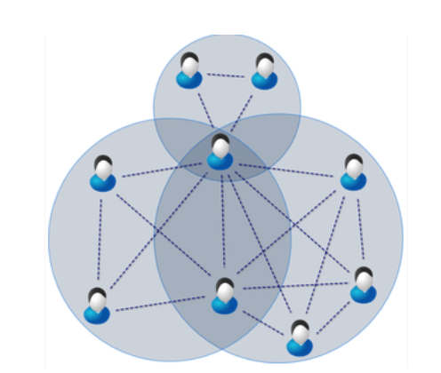
Maximum Clique
Given a graph G=(V,E)
A clique is a vertex subset C such that every vertex in C is adjacent to any other vertices in C.
Problem: Find a clique with the maximum size.
Applications: social network, protein structure analysis

Slide 4
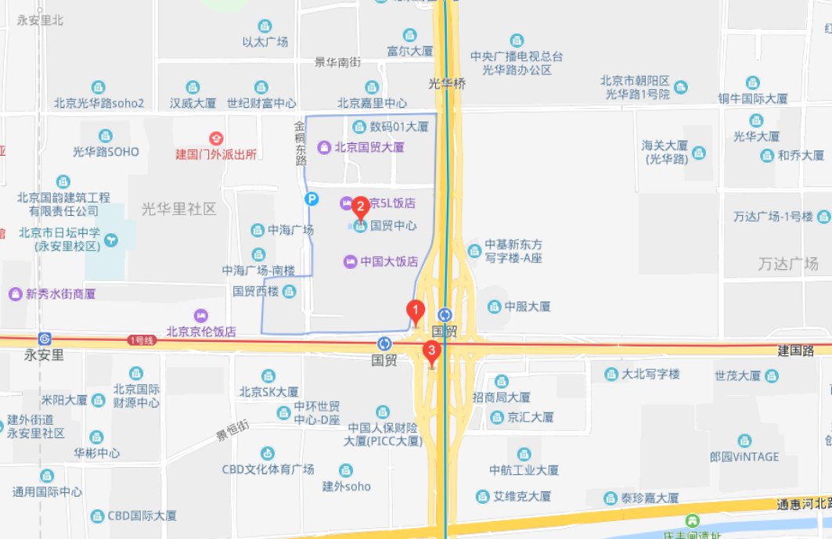
Maximum Independent Set
Given a graph G=(V,E)
An Independent set is a vertex subset C such that every vertex in C is not adjacent to any other vertices in C.
Problem: Find an independent set with the maximum size.
Applications: map labeling….

Slide 5

Minimum Vertex Cover
Given a graph G=(V,E)
A vertex cover is a vertex subset C such that every edge in G has at least one vertex in C.
Problem: Find a vertex cover with the minimum size.
Applications: Monitoring link failures in network (at which nodes of the network to put the monitor, so that we can know all the status of the every linkage)

Slide 6
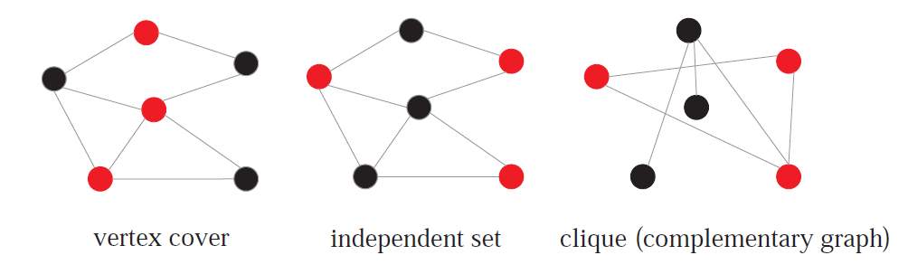
Clique, independent set, vertex cover
The concepts are illustrated with red points.
NP complete problems can be reduced to each other in polynomial time.

Slide 7
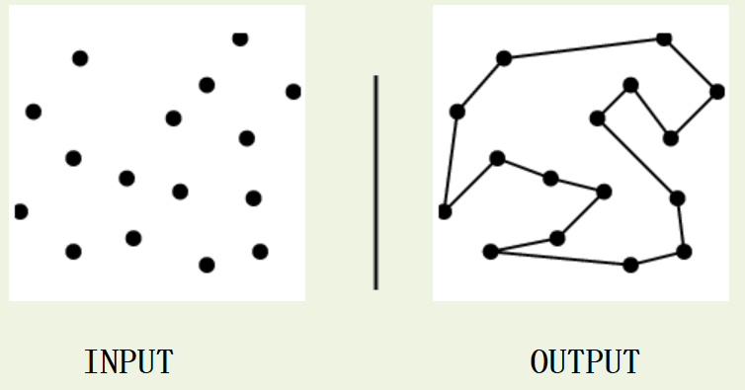
Traveling Salesman Problem
Input: A weighted graph G.
Problem: Find the cycle of minimum cost visiting all of the vertices of G exactly once.
Application: optimizing the paths for manufacturing equipment.

Slide 8
P Median Problem
Input: a set of candidate facilities, a set of clients
Problem: find p facilities to serve all clients, to optimize the cost (can be sum of serving distances)
Applications: logistics…

Slide 9


Bin Packing
Input: objects of different volumes, a finite number of bins each of volume V
Problem: objects must be packed into the bins in a way that minimizes the number of bins used.
Applications: filling up containers, loading trucks, creating file backs in media and technology mapping in FPGA and chip design.

Slide 10
Combinatorial Problems
More combinatorial problems:
vertex coloring
scheduling, time-tabling
resource allocation
Path planning
…

Slide 11
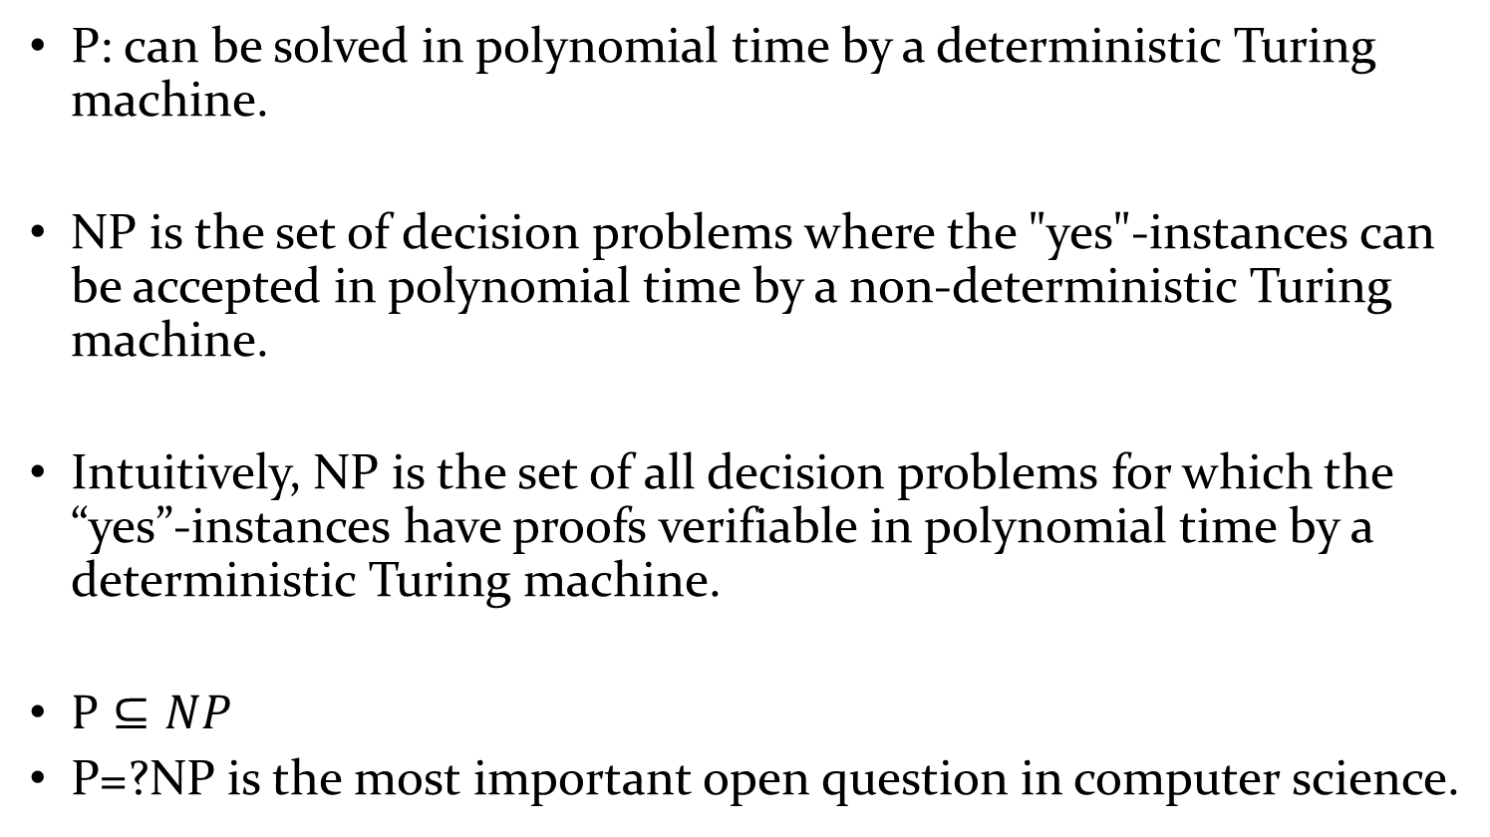
P vs. NP
P: can be solved in polynomial time by a deterministic Turing machine.
NP is the set of decision problems where the "yes"-instances can be accepted in polynomial time by a non-deterministic Turing machine.
Intuitively, NP is the set of all decision problems for which the “yes”-instances have proofs verifiable in polynomial time by a deterministic Turing machine.
$P⊆NP$
P=?NP is the most important open question in computer science.

Slide 12
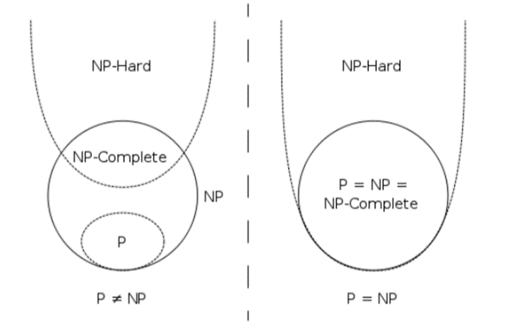
Combinatorial Problems are Hard
Many Combinatorial Optimization problems are usually NP-hard
NP-complete is a class of problems such that, any problem in NP can be reduced to such a problem in polynomial time.
NP-hardness is a class of problems that are, informally, "at least as hard as the hardest problems in NP (i.e. NP complete)".

Slide 13
Prove NP Completeness of a new problem
If we want to prove a problem X is NP complete, we need to reduce a NP-complete problem to X.
E.g. If we already know SAT is NPC, then to prove 3-SAT is NPC, we need to reduce SAT to 3-SAT.
For any SAT problem F, construct a 3-SAT problem F’=f(F), such that F is satisfiable ⬄F’ is satisfiable.

Slide 14
Tackling Combinatorial Optimization
Theoretical results: Computational complexity tells us that many combinatorial optimization problems are NP-hard.
Tackle hard combinatorial problems, theoretically..
Some subclasses of the problem can be easy
Approximation algorithms
Randomized (probabilistic) algorithms
Parameterized algorithms
…

Slide 15

The gap between theory and practice

Slide 16
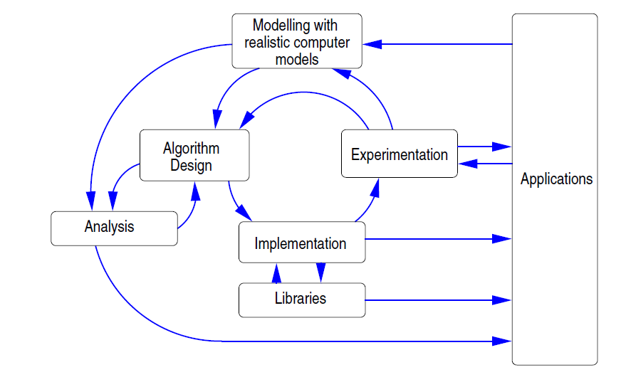
Algorithm Engineering
from 《 Algorithm engineering: Bridging the Gap between Algorithm Theory and Practice 》

Slide 17
This part of course focuses on :
Tackle hard combinatorial problems, practically!
General Models
Local Search
Reduction Rules
Others

Slide 18
Facing with a new problem?
Don’t want to develop an algorithm?
The developed algorithm has bad performance?
Too much cost for developing a new algorithm?
Too complicated?
Lazy?
One way out is to use general solvers.

Slide 19
General Models

Slide 20

Hello, SAT!
The first NP-Complete problem [Cook, 1971]
Conceptually simple and easy to describe
Many theoretical results
Many important applications
Open source benchmarks and solvers
Annual competition

Slide 21
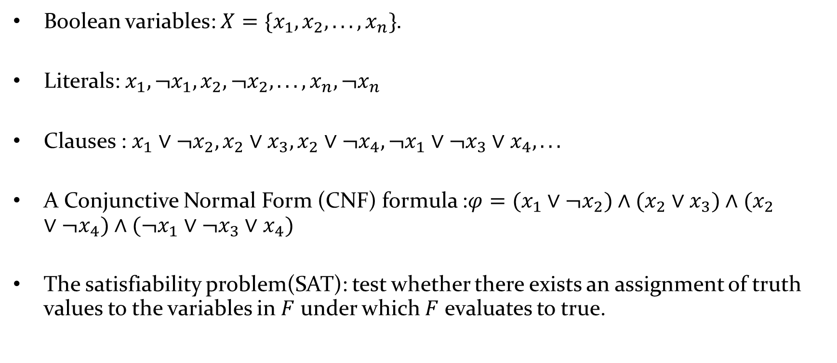
Boolean Satisfiability (SAT)
Boolean variables: $X=\{x_{1},x_{2},...,x_{n}\}$.
Literals: $x_{1},¬x_{1},x_{2},¬x_{2},...,x_{n},¬x_{n}$
Clauses : $x_{1}∨¬x_{2},x_{2}∨x_{3},x_{2}∨¬x_{4},¬x_{1}∨¬x_{3}∨x_{4},...$
A Conjunctive Normal Form (CNF) formula :$φ=(x_{1}∨¬x_{2})∧(x_{2}∨x_{3})∧(x_{2}∨¬x_{4})∧(¬x_{1}∨¬x_{3}∨x_{4})$
The satisfiability problem(SAT): test whether there exists an assignment of truth values to the variables in $F$ under which $F$ evaluates to true.

Slide 22
Boolean Satisfiability (SAT)
Example: Determine the satisfiability of the following compound propositions:
Solution: Satisfiable. Assign T to p, q, and r.
Solution: Satisfiable. Assign T to p and F to q.
Solution: Not satisfiable. Check each possible assignment of truth values to the propositional variables and none will make the proposition true.

Slide 23
Applications of SAT
Hardware Model Checking
All major hardware companies (Intel, ...) use SAT sovler to verify their chip desgins
Software Verification
SAT solver based SMT solvers are used to verify Microsoft software products
Embedded software in Cars, Aiplanes, Refrigerators, ...
Unix utilities
Automated Planning and Scheduling
Still one of the best approaches for optimal planning
Number Theoretic Problems (Pythagorean Triples)
Solving other NP-hard problems (coloring, clique, ...)

Slide 24
Encoding Coloring to SAT
Encoding graph coloring problem to SAT
Graph coloring: given a graph G, an integer k, whether the vertices can be colored using k colors s.t. all neighboring vertices have different colors?
A traditional encoding:
for each vertex, uses k variables (n vertices), nK in all.
x_{11,} x₁₂ … x_{1k,} x_{21,} x₂₂ … x_{2k,} … x_{n1,} x_{n2} … x_{nk}
x_{ic} means vertex i has color c.
For each edge, produces k negative 2-clause
For each vertex, produces a positive k-clauses
For each vertex, produces C(2,k) clauses to avoid being colored by more than one color. (Redundant in practical use)

Slide 25
4
3-coloring:
for each vertex, uses 3 variables (n vertices), 4*3 in all.
x_{11,} x_{12,} x_{13,} x_{21,} x_{22,} x_{23 ,} x_{31,} x_{32,} x_{33 ,} x_{41,} x_{42,} x₄₃
For each edge, produces 3 negative 2-clause
edge1-2: ¬ x₁₁ꓦ¬x₂₁, ¬ x₁₂ꓦ¬x₂₂, ¬ x₁₃ꓦ¬x₂₃;
edge1-4: ¬ x₁₁ꓦ¬x₄₁, ¬ x₁₂ꓦ¬x₄₂, ¬ x₁₃ꓦ¬x₄₃;
edge2-3: ¬ x₂₁ꓦ¬x₃₁, ¬ x₂₂ꓦ¬x₃₂, ¬ x₂₃ꓦ¬x₃₃;
edge2-4: ¬ x₂₁ꓦ¬x₄₁, ¬ x₂₂ꓦ¬x₄₂, ¬ x₂₃ꓦ¬x₄₃;
edge3-4: ¬ x₃₁ꓦ¬x₄₁, ¬ x₃₂ꓦ¬x₄₂, ¬ x₃₃ꓦ¬x₄₃;
For each vertex, produces a positive k-clauses
x₁₁ꓦx₁₂ꓦx_{13,} x₂₁ꓦx₂₂ꓦx_{23,} x₃₁ꓦx₃₂ꓦx_{33,} x₄₁ꓦx₄₂ꓦx₄₃
Result:
x_{11,} ¬ x_{12,} ¬ x_{13,} ¬ x_{21,} x_{22,} ¬ x_{23 ,} x_{31,} ¬ x_{32,} ¬ x_{33 ,} ¬ x_{41,} ¬ x_{42,} x₄₃
1
3
Color 1
2
Color 2
Color 3
4
1
3
2

Slide 26
Who is Lying
Questions:
A: B is lying.
B: C is lying.
C: A and B is lying.
so, who is not lying?
Encoding:
3 variables: a, b, c present A, B, C speak truth, while ¬a, ¬b, ¬c present lying.
clauses:
a V b V c ; %at least one speak truth.
¬ a V ¬ b; a V b; %a-> ¬b, ¬a -> b
¬ b V ¬ c; b V c; %b-> ¬c, ¬b -> c
¬ c V ¬ a; ¬c V ¬b; c V a V b %c->(¬aꓥ ¬b), ¬c->¬ (¬aꓥ ¬b)
result: ¬a, b, ¬c
b speaks truth, a, c are lying

Slide 27
Encoding Circuit to SAT
c
c
&
≥1
&
Assume a circuit consists only “AND” (c = a ^ b) logic.
“OR” logic can be presented by “AND” logic.
E.g. transfer circuit (3) to SAT
the input of this circuit is x1, x2
1) x3 ↔ x1 ꓥ x2
¬ x3 V x1; ¬x3 V x2; ¬ x1 V ¬ x2 V x3
2) x4 ↔ ¬ x1 ꓥ ¬ x2
¬ x4 V ¬ x1 ; ¬ x4 V ¬ x2; x1 V x2 V x4
3) x5 ↔ x3 ꓥ ¬ x4
¬ x5 V x3 ; ¬ x5 V ¬ x4; ¬ x3 V x4 V x5
To verify whether some property P holds for a circuit:
Test Satisfiability: F ꓥ ¬ P
a
b
a
b
(1)AND
(2)OR
a, b, c present variables.
x₅
&
x₃
x₄
&
&
x₁
x₂
x₁
x₂
(3)
x₁,…,x₅ present variables.

Slide 28
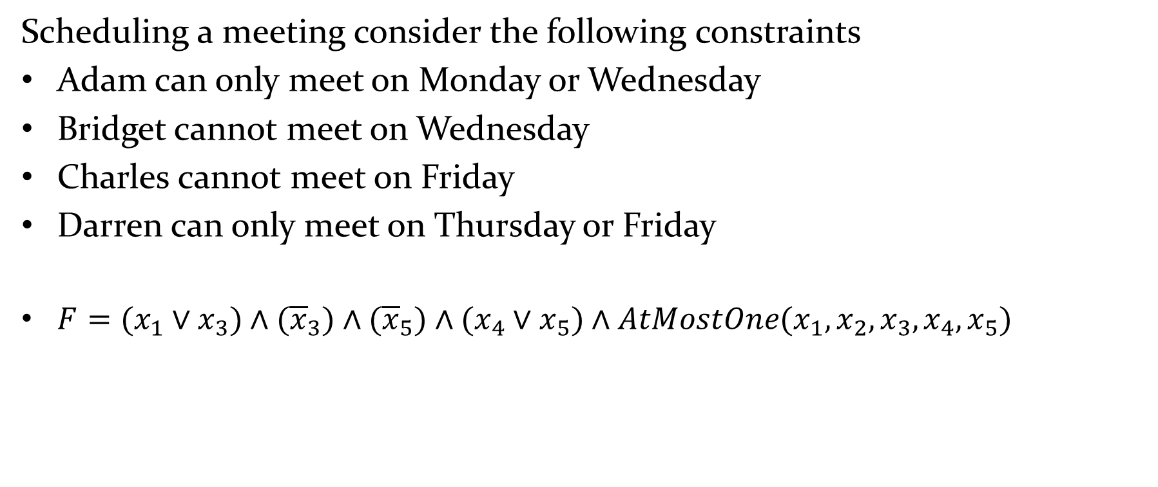
Encoding Meeting Scheduling to SAT
Scheduling a meeting consider the following constraints
Adam can only meet on Monday or Wednesday
Bridget cannot meet on Wednesday
Charles cannot meet on Friday
Darren can only meet on Thursday or Friday
$F=(x_{1}∨x_{3})∧({\overline{x}}_{3})∧({\overline{x}}_{5})∧(x_{4}∨x_{5})∧AtMostOne(x_{1},x_{2},x_{3},x_{4},x_{5})$

Slide 29



$$F=(x_{1}∨x_{3})∧({\overline{x}}_{3})∧({\overline{x}}_{5})∧(x_{4}∨x_{5})$$
$$∧({\overline{x}}_{1}∨{\overline{x}}_{2})∧({\overline{x}}_{1}∨{\overline{x}}_{3})∧({\overline{x}}_{1}∨{\overline{x}}_{4})∧({\overline{x}}_{1}∨{\overline{x}}_{5})$$
$$∧({\overline{x}}_{2}∨{\overline{x}}_{3})∧({\overline{x}}_{2}∨{\overline{x}}_{4})∧({\overline{x}}_{2}∨{\overline{x}}_{5})$$
$$∧({\overline{x}}_{3}∨{\overline{x}}_{4})∧({\overline{x}}_{3}∨{\overline{x}}_{5})$$
$$∧\left({\overline{x}}_{4}∨{\overline{x}}_{5}\right)$$
Solution: Unsatisfiable, i.e., it is impossible to schedule a meeting with these constraints

Slide 30
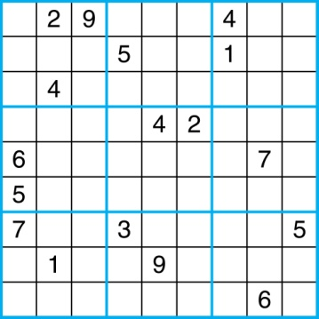
Encoding Sudoku to SAT
A Sudoku puzzle is represented by a 9×9 grid made up of nine 3×3 subgrids, known as blocks. Some of the 81 cells of the puzzle are assigned one of the numbers 1,2, …, 9.
The puzzle is solved by assigning numbers to each blank cell so that every row, column and block contains each of the nine possible numbers.
Example

Slide 31
Let p(i,j,n) denote the proposition that is true when the cell in the ith row and the jth column has number n.
Those variables that are assigned T yield a solution to the puzzle.
There are 9×9 × 9 = 729 such propositions.
In the sample puzzle p(5,1,6) is true, but p(5,j,6) is false for j = 2,3,…9

Slide 32
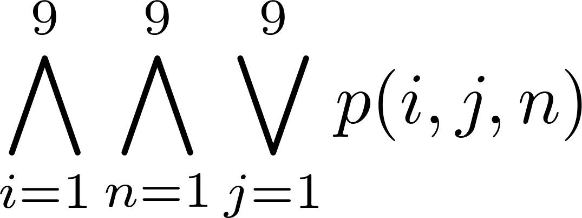
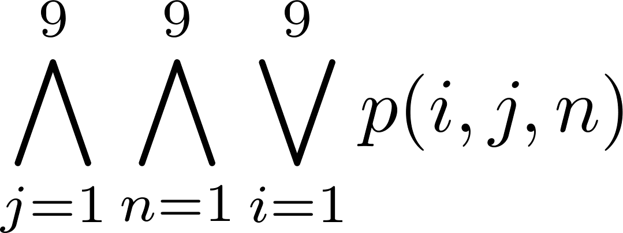
For each cell with a given value(已经有数字的cell), assert p(i,j,n), when the cell in row i and column j has the given value.
Assert that every row contains every number.
Assert that every column contains every number.

Slide 33

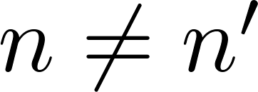
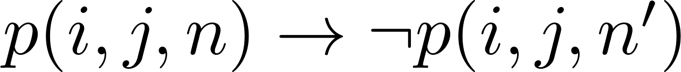
Assert that each of the 3 x 3 blocks contain every number.
Assert that no cell contains more than one number. Take the conjunction over all values of n, n’, i, and j, where each variable ranges from 1 to 9 and ,

Slide 34
Encoding Sokoban to SAT
Variables – For each location we have variable, the domain is WORKER, BOX, EMPTY
Initial State – assign values based on the picture
Goal – goal position variables have value BOX
Actions – move and push for each possible location
push(L1; L2; L3)
= ({L1 = W; L2 = B; L3 = E}; {L1 = E; L2 = W; L3 = B}).
move(L1; L2) = ({L1 = W; L2 = E}; {L1 = E; L2 = W})
We cannot encode the existence of a plan in general
But we can encode the existence of plan up to some length

Slide 35
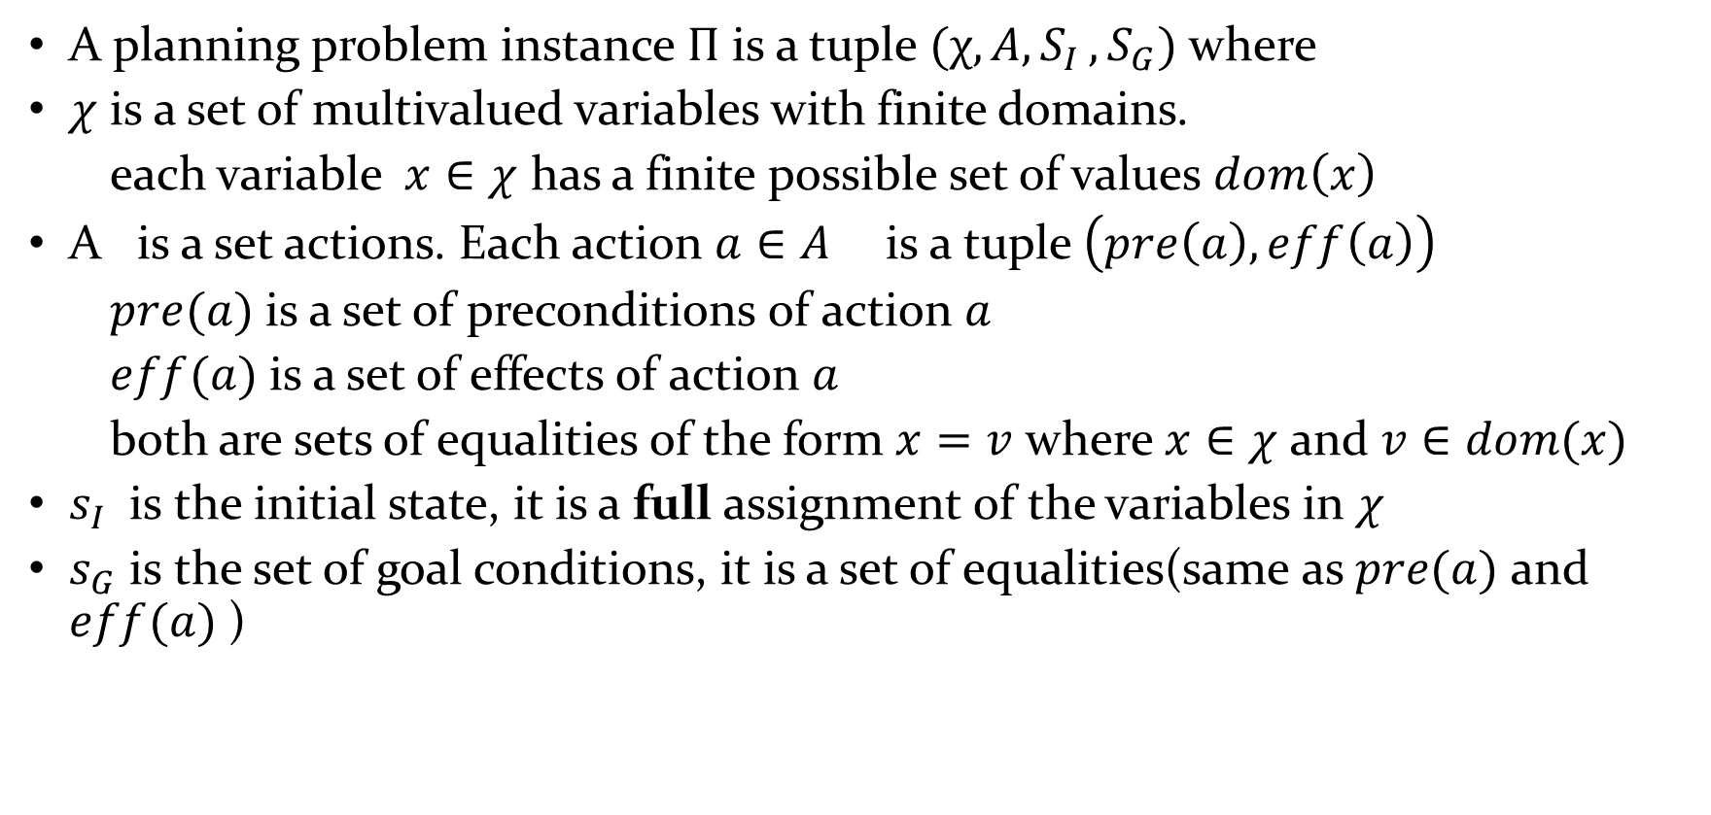
Planning Problem Definition
A planning problem instance $Π$ is a tuple $(χ, A{,S}_{I}, S_{G})$ where
$χ$ is a set of multivalued variables with finite domains.
each variable $x∈χ$ has a finite possible set of values $dom\left(x\right)$
A is a set actions. Each action $a∈A$ is a tuple $\left(pre\left(a\right), eff\left(a\right)\right)$
$pre(a)$ is a set of preconditions of action $a$
$eff(a)$ is a set of effects of action $a$
both are sets of equalities of the form $x=v$ where $x∈χ$ and $v∈dom(x)$
$s_{I}$ is the initial state, it is a full assignment of the variables in $χ$
$s_{G}$ is the set of goal conditions, it is a set of equalities(same as $pre(a)$ and $eff(a)$ )

Slide 36
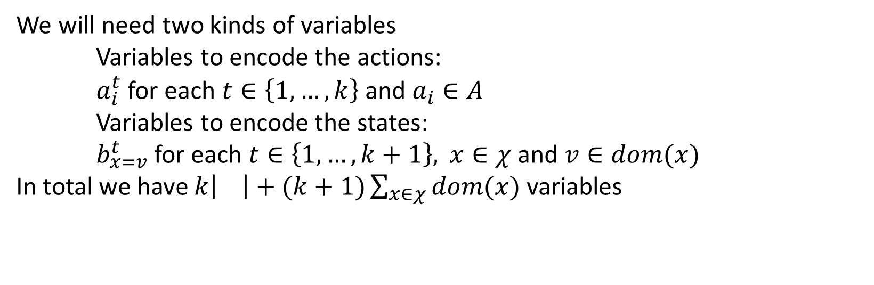

The task
Given a planning problem instance $Π=\left(χ, A, s_{I}, S_{G}\right)$ and $k∈N$ construct a CNF formula $F$ sus that $F$ satisfiable if and only if there is plan of length$k$ for $Π$
We will need two kinds of variables
Variables to encode the actions:
$a_{i}^{t}$ for each $t∈\left\{1,…,k\right\}$ and $a_{i}∈A$
Variables to encode the states:
$b_{x=v}^{t}$ for each $t∈\left\{1,…,k+1\right\},$ $x∈χ$ and $v∈dom(x)$
In total we have $k\left| \right|+(k+1)\sum_{x∈χ}{dom(x)}$ variables

Slide 37
We will need 8 kinds of clauses
The first state is the initial state
The goal conditions are satisfied in the end
Each state variable has at least one value
Each state variable has at most one value
If an action is applied it must be applicable
If an action is applied its effects are applied in the next step
State variables cannot change without an action between steps
At most one action is used in each step

Slide 38
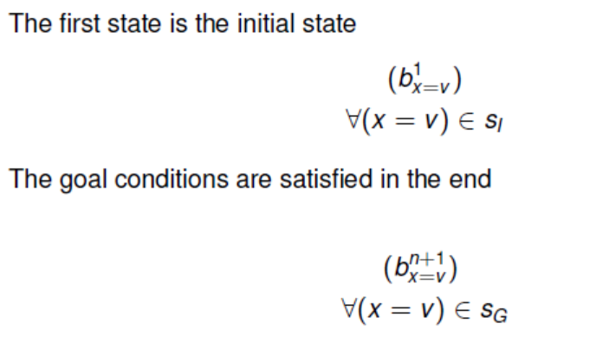

Slide 39
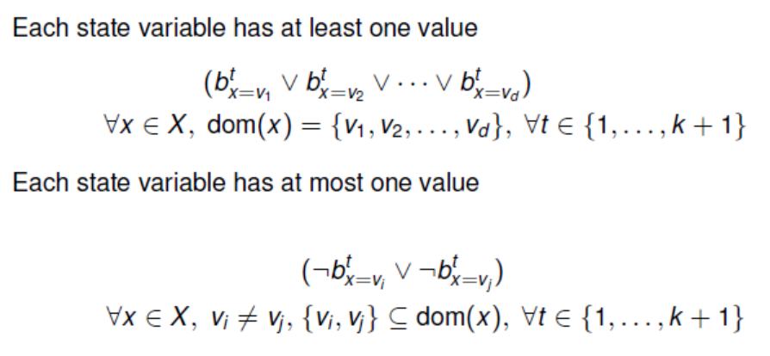

Slide 40
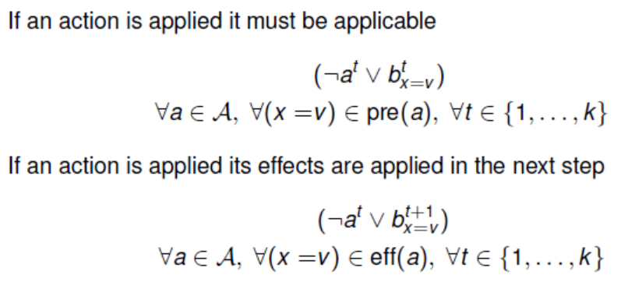

Slide 41
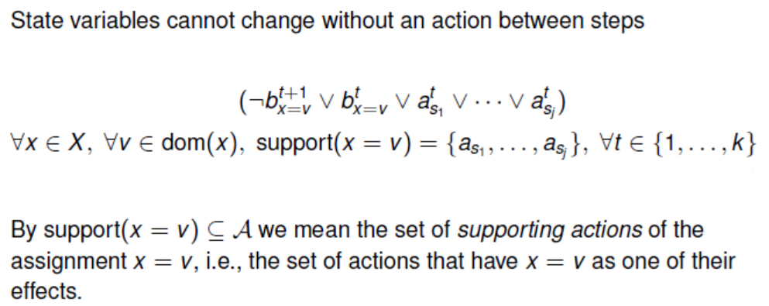

Slide 42
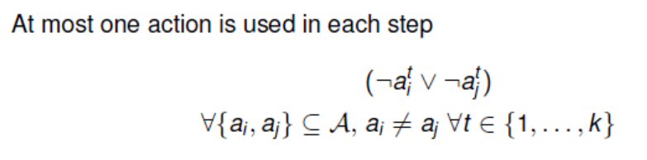

Slide 43
Find SAT Solvers
Today, SAT solvers can handle formulas with millions of variables.
SAT competitions
Keep your eyes on recent improvements
Find them on the homepages
Or, you can send emails

Slide 44
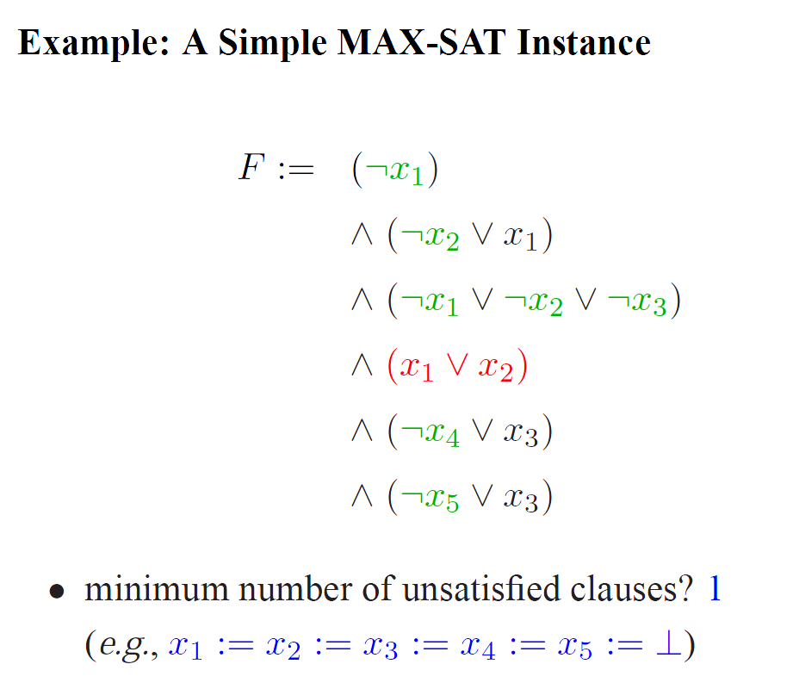
MaxSAT
When the formula is not satisfiable, we concern about satisfying as many clauses as possible -> Maximum Satisfiability.

Slide 45
Partial MaxSAT
hard clauses, soft clauses
the goal: satisfy all hard clauses and as many soft clauses as possible.
Encoding MaxClique to Partial MaxSAT
for each vertex, uses one variable. x_{i} = 1 means vertex x is selected.
For each pair of vertices not adjacent, produces a negative 2-clause as hard clause, saying they cannot be both chosen.
For each vertex, produces a positive unit clause as soft clause.

Slide 46
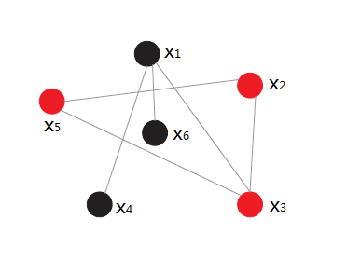
Encoding MaxClique to Partial MaxSAT
MaxClique Problem
Partial MaxSAT
hard clauses:
soft clauses:
Graph: G=(E, V)

Slide 47
Encoding Set Cover to Partial MaxSAT
Set cover Problem
Given:
U={1,2,3,4}, X={x1,x2,x3,x4}
x1={2,3}
x2={1,2}
x3={1,3,4}
x4={2,4}
Goal: minimize k
Partial MaxSAT
hard clauses:
soft clauses:

Slide 48
Weighted Partial MaxSAT
Finally, we can distinguish the importance of soft clauses by weights
hard clauses, (soft clauses, soft weights)
the goal: satisfy all hard clauses and the largest weight of soft clauses.

Slide 49
Constraint Satisfiability Problem (CSP)
Constraint Satisfiability Problem
P=<X,D,C>
X: variables
D: domains
C: constraints
Express constraints
Extensional
Intensional
Encoding the n-queue problem to CSP
Q
Q
Q
Q
Variables: x₁, x₂, x₃, x₄

Slide 50
Constraint Satisfiability Problem (CSP)
Constraint Satisfiability Problem
P=<X,D,C>
X: variables
D: domains
C: constraints
Express constraints
Extensional
Intensional
Encoding the n-queue problem to CSP
Q
Q
Q
Q
Variables: x₁, x₂, x₃, x₄
D₁, D₂, D₃, D₄ (D_{i} = {1,2,3,4})
x_{i} ≠ x_{j} (0<i<j≤n) ;
|x_{i}-x_{j}| ≠ |i-j|. (0<i<j≤n)
Notes:
这里不需要考虑同一列不能出现两个皇后的冲突，因为我们的变量是定义在一列上的，比如x2取1，就表示第二列只有第一格有皇后。因为这个变量不能同时取两个值，也就表示了列冲突了。

Slide 51
Satisfiability Modulo Theories (SMT)
Satisfiability Modulo Theories
Propositional logic is usually not sufficient in many problems.
First Order Logic: powerful to express most real world applications.
But, first order logic is generally undecidable!
SMT: takes segments of first order logic
Only considers certain background theories.

Slide 52
What is a SMT instance?
A logical formula built using
negation, conjunction and disjuction
e.g. $a∧\left(b∨c\right)$
e.g. $\left(a∨¬b∨c\right)∧\left(¬b∨¬x∨y\right)∧\left(b∨b∨x\right)$
theory specific operators
e.g. $x≤5$, $y≠z$
e.g. $\left(m⊕n\right)⊕n=m$
e.g. $f\left(x\right)=f(y)∧f(f\left(x\right))≠f(f\left(y\right))$
k-SAT
theory of bitwise operators
theory of integers
theory of uninterpreted functions

Slide 53
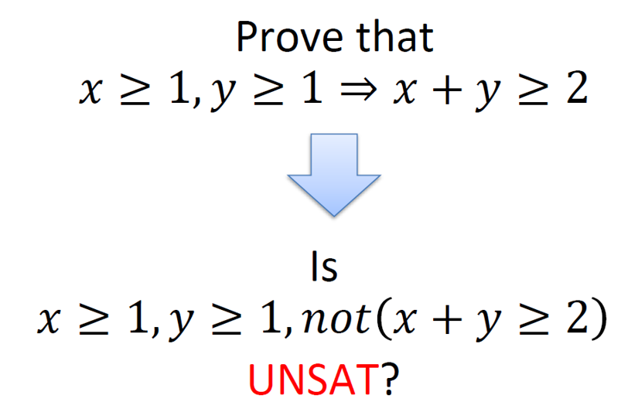
Checking validity by SMT

Slide 54
Satisfiability Modulo Theories (SMT)
Theory of:
Difference Arithemetic
Linear Arithmetic
Arrays
Bit Vectors
Algebraic Datatypes
Uninterpreted Functions
A modeling language for SMT instances
A declarative language with Lisp-like syntax
http://www.smtlib.org/
Powerful SMT solvers
Z3 (http://research.microsoft.com/projects/z3)
Yices (http://yices.csl.sri.com)
CVC

Slide 55
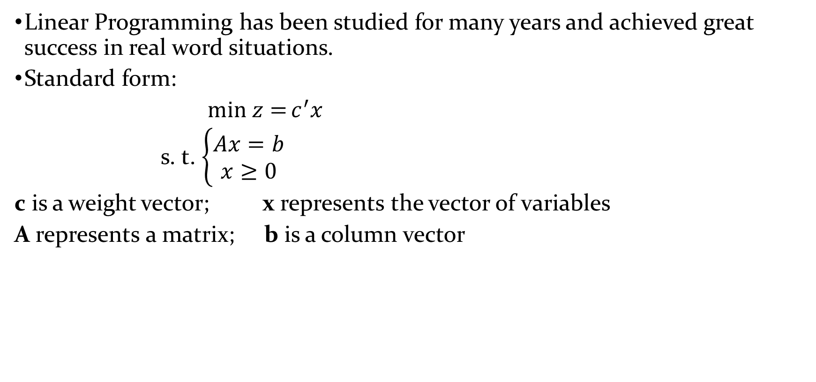
Linear Programming (LP)
Linear Programming has been studied for many years and achieved great success in real word situations.
Standard form:
$min z={c^{′}x}$
s. t. $\left\{\begin{aligned}Ax=b \\ x≥0\end{aligned}\right.$
c is a weight vector; x represents the vector of variables
A represents a matrix; b is a column vector

Slide 56
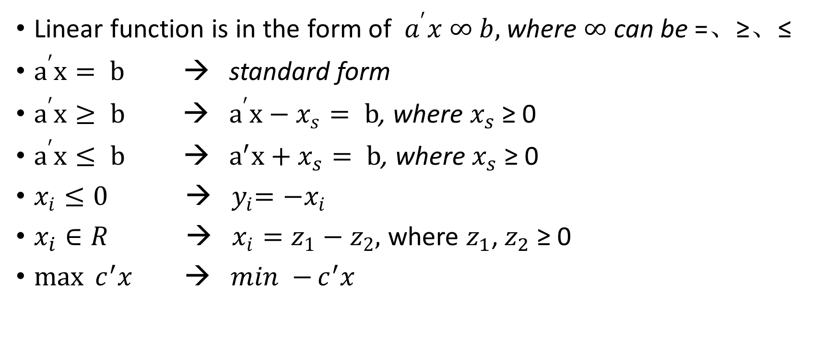
LP
Linear function is in the form of $a^{′}x ∞ b,$where $∞$ can be =、≥、≤
$a^{′}x= b$ → standard form
$a^{′}x≥ b$ → $a^{′}x−x_{s}= b$, where $x_{s}$ ≥ 0
$a^{′}x≤ b$ → ${ a}^{′}x+x_{s}= b$, where $x_{s}$ ≥ 0
$x_{i}≤0$ → ${ y}_{i}=−x_{i}$
$x_{i}∈R$ → $x_{i}=z_{1}−z_{2},$ where $z_{1}$, $z_{2}$ ≥ 0
$\max{c^{′}x}$ → $min −{c^{′}x}$

Slide 57
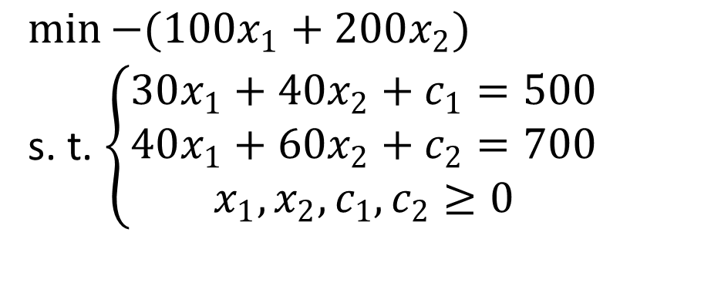

LP
Example:
$\max{100x_{1}+200x_{2}}$
s. t. $\left\{\begin{aligned}30x_{1}+40x_{2}≤500 \\ 40x_{1}+60x_{2}≤700 \\ x_{1},x_{2}≥0\end{aligned}\right.$ →
$$\min{−(100x_{1}+200x_{2})}$$
s. t. $\left\{\begin{aligned}30x_{1}+40x_{2}+c_{1}=500 \\ 40x_{1}+60x_{2}+c_{2}=700 \\ x_{1},x_{2},c_{1},c_{2}≥0\end{aligned}\right.$
Turn to standard form
Apply the general LP solver
→The main methods are simplex method, dual simplex method

Slide 58
ILP and MILP
If all the variables in LP are restricted to integers, the resulting problem is Integer Linear Programming (ILP)
If olny a part of the variables in LP is restricted to integers, the resulting problem is Mix Integer Linear Programming (MILP)
Encoding problems into ILP or MILP
Apply specific solvers like Gurobi

Slide 59
Example:
Three kinds of food: corn, milk and bread.
s.t. : 1. the total intake of vitamin A is not less than 500
2. the total intake of Vitamin B is not less than 1000
Goal: minimize the total cost
Food | Cost per serving | Vitamin A | Vitamin B
Corn | $0.18 | 107 | 72
Milk | $0.23 | 500 | 121
Wheat Bread | $0.05 | 0 | 65

Slide 60
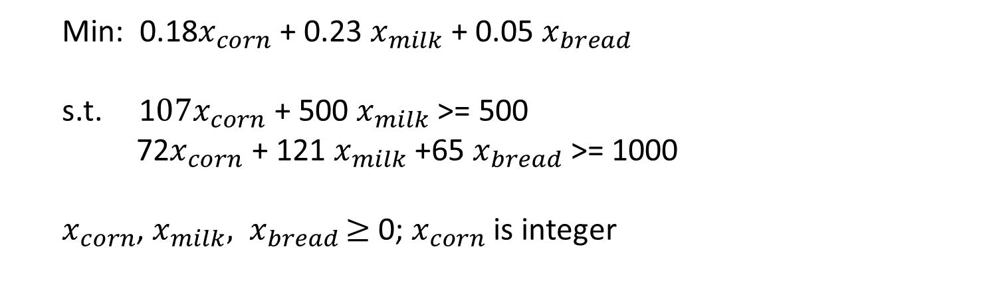
Example:
Food | Cost per serving | Vitamin A | Vitamin B
Corn | $0.18 | 107 | 72
Milk | $0.23 | 500 | 121
Wheat Bread | $0.05 | 0 | 65
s.t. : 1. the total intake of vitamin A is not less than 500 Goal: minimize the total cost
2. the total intake of Vitamin B is not less than 1000
Min: 0.18$x_{corn}$ + 0.23 $x_{milk}$ + 0.05 $x_{bread}$
s.t. 1$07x_{corn}$ + 500 $x_{milk}$ >= 500
72$x_{corn}$ + 121 $x_{milk}$ +65 $x_{bread}$>= 1000
$x_{corn}$, $x_{milk}{, x}_{bread}≥$0; $x_{corn}$ is integer

Slide 61
Encoding Nurse Rostering to ILP
Nurse Rostering :
The basic problem consists in the weekly scheduling of a fixed number of nurses using a set of shifts, such that in each day a nurse works a shift or has a day-off.
Nurses may have multiple skills, and for each skill we are given different coverage requirements.

Slide 62
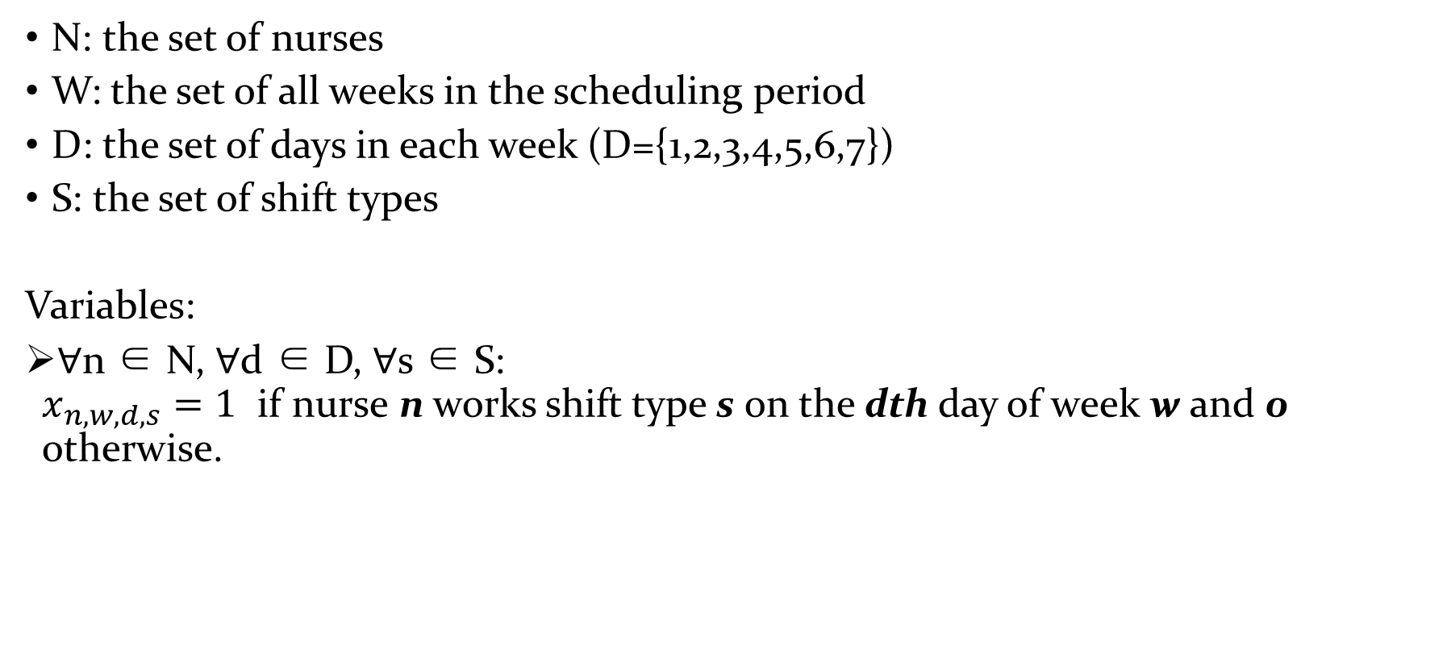
Data and variables
N: the set of nurses
W: the set of all weeks in the scheduling period
D: the set of days in each week (D={1,2,3,4,5,6,7})
S: the set of shift types
Variables:
∀n ∈ N, ∀d ∈ D, ∀s ∈ S: $x_{n,w,d,s}=1$ if nurse n works shift type s on the dth day of week w and 0 otherwise.

Slide 63
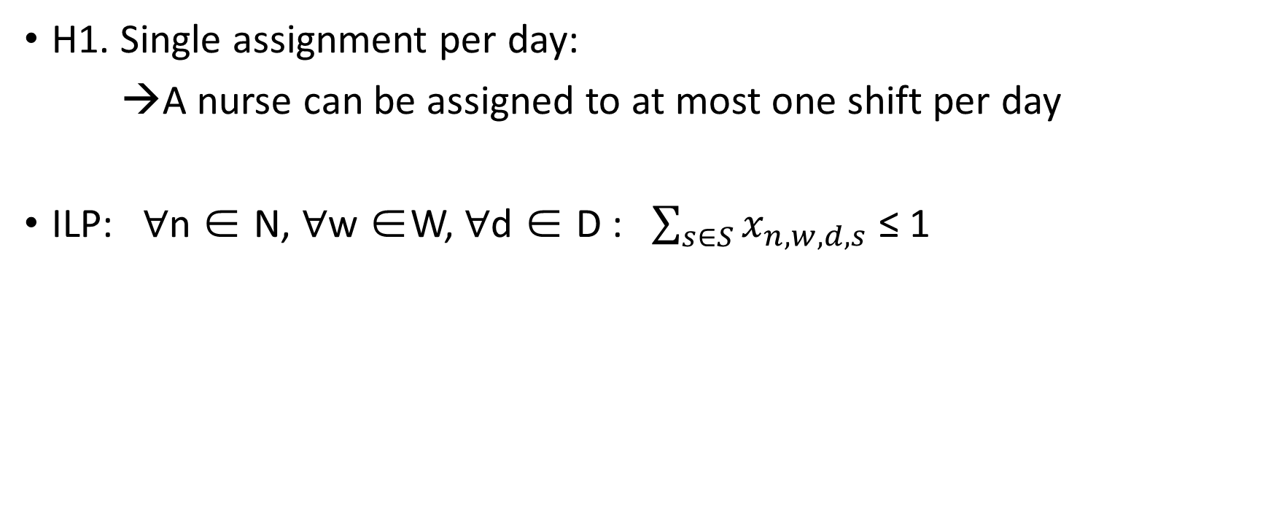
Hard (H) constraint types:
H1. Single assignment per day:
→A nurse can be assigned to at most one shift per day
ILP: ∀n ∈ N, ∀w ∈W, ∀d ∈ D : $\sum_{s∈S}{x_{n,w,d,s}}$ ≤ 1

Slide 64
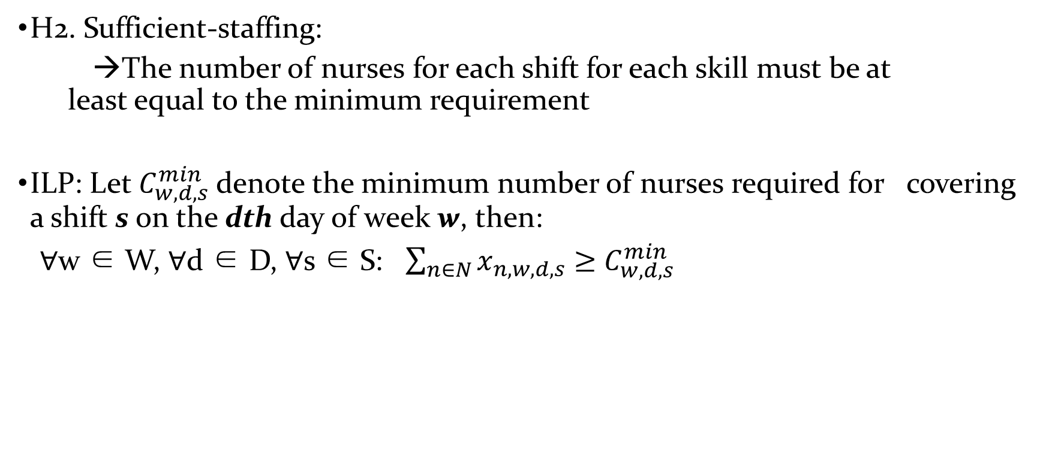
Hard (H) constraint types:
H2. Sufficient-staffing:
→The number of nurses for each shift for each skill must be at least equal to the minimum requirement
ILP: Let $C_{w,d,s}^{min}$denote the minimum number of nurses required for covering a shift s on the dth day of week w, then:
∀w ∈ W, ∀d ∈ D, ∀s ∈ S: $\sum_{n∈N}{x_{n,w,d,s}}$ $≥$ $C_{w,d,s}^{min}$

Slide 65
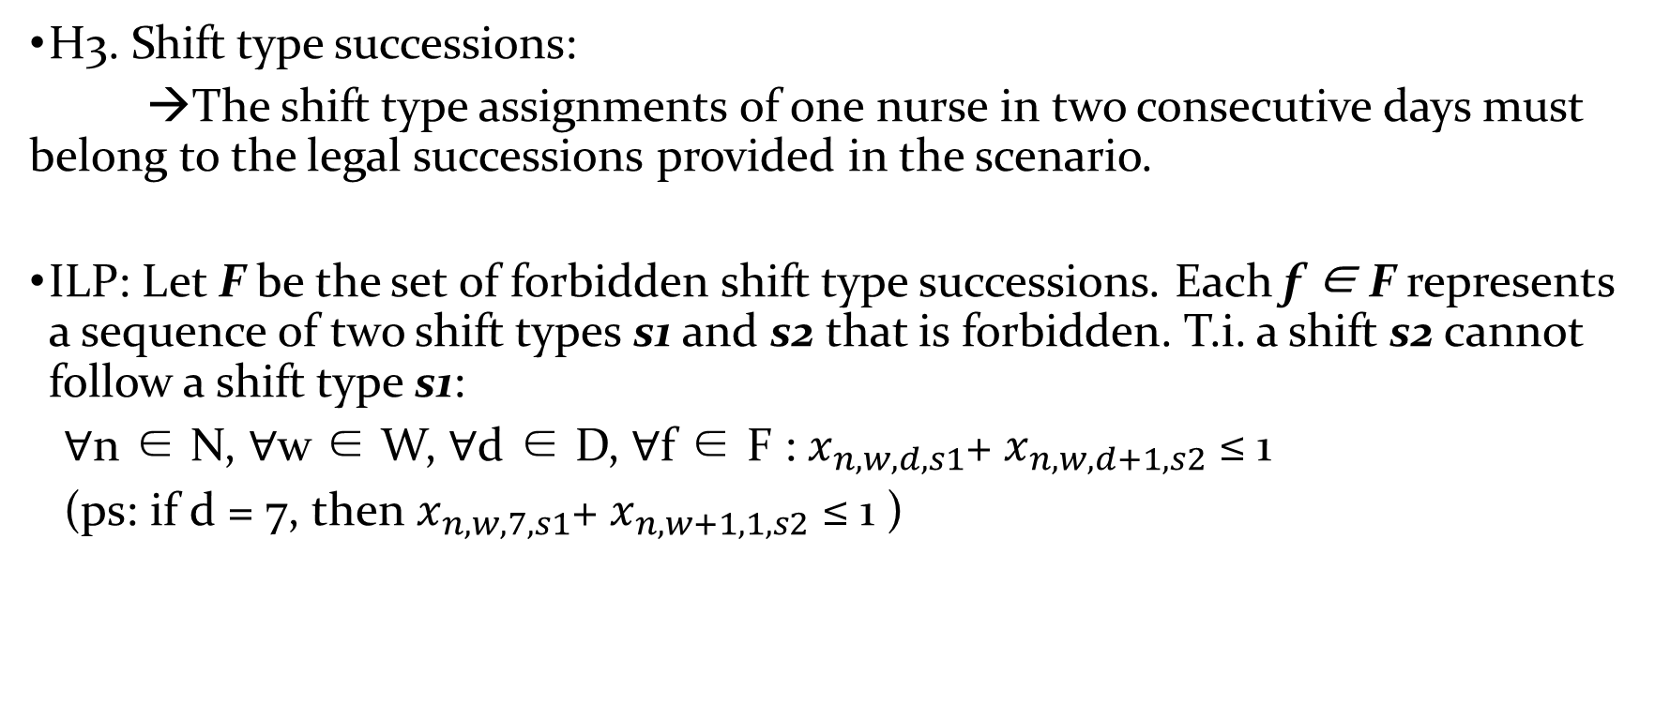
Hard (H) constraint types:
H3. Shift type successions:
→The shift type assignments of one nurse in two consecutive days must belong to the legal successions provided in the scenario.
ILP: Let F be the set of forbidden shift type successions. Each f ∈ F represents a sequence of two shift types s1 and s2 that is forbidden. T.i. a shift s2 cannot follow a shift type s1:
∀n ∈ N, ∀w ∈ W, ∀d ∈ D, ∀f ∈ F : $x_{n,w,d,s1}$+ $x_{n,w,d+1,s2}$ ≤ 1
(ps: if d = 7, then $x_{n,w, 7,s1}$+ $x_{n,w+1, 1,s2}$ ≤ 1 )

Slide 66
Soft (S) constraints types:
Allowed falsified
Incur a penalty to the cost

Slide 67
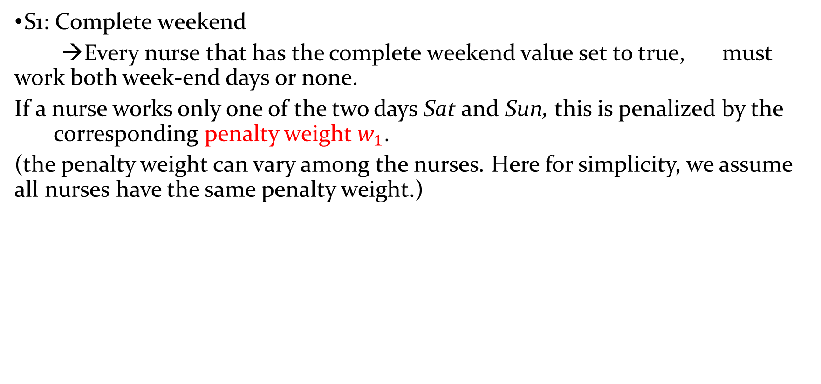
Soft (S) constraints types:
S1: Complete weekend
→Every nurse that has the complete weekend value set to true, must work both week-end days or none.
If a nurse works only one of the two days Sat and Sun, this is penalized by the corresponding penalty weight $w_{1}$.
(the penalty weight can vary among the nurses. Here for simplicity, we assume all nurses have the same penalty weight.)

Slide 68
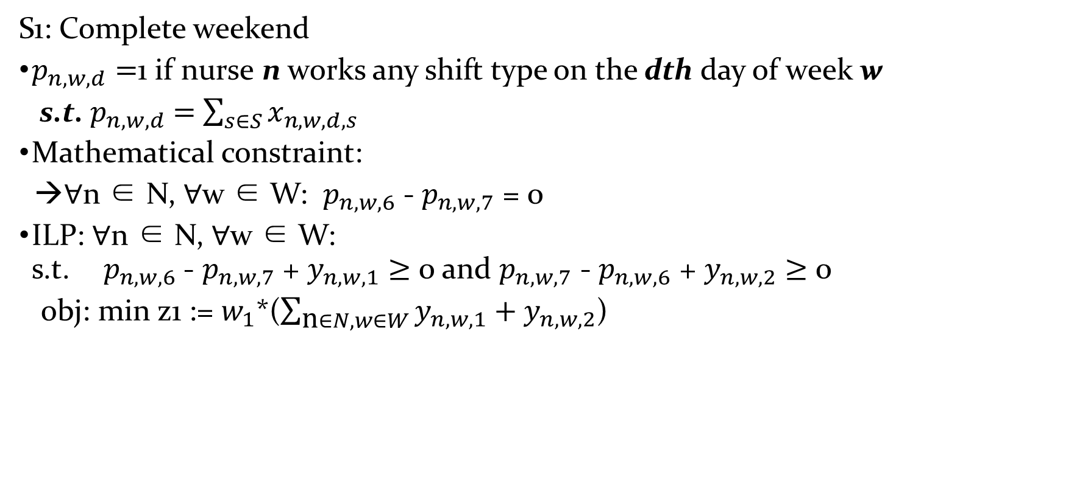
Soft (S) constraints types:
S1: Complete weekend
$p_{n,w,d}=$1 if nurse n works any shift type on the dth day of week w
s.t. $p_{n,w,d}$ $=$ $\sum_{s∈S}{x_{n,w,d,s}}$
Mathematical constraint:
→∀n ∈ N, ∀w ∈ W: $p_{n,w,6}$ - $p_{n,w,7}$ = 0
ILP: ∀n ∈ N, ∀w ∈ W: s.t.${ p}_{n,w,6}$ - $p_{n,w,7}$ + $y_{n,w,1}$ $≥$ 0 and $p_{n,w,7}$ - $p_{n,w,6}$ + $y_{n,w,2}$ $≥$ 0
obj: min z1 := $w_{1}$*($\sum_{\text{n}∈N, w∈W}{y_{n,w,1}}+y_{n,w,2}$)

Slide 69
Soft (S) constraints types:
S2: Total assignments
→For each nurse the total number of assignments (working days) must at least reach the minimum requirement. The difference, multiplied by its weight, is added to the objective function.

Slide 70
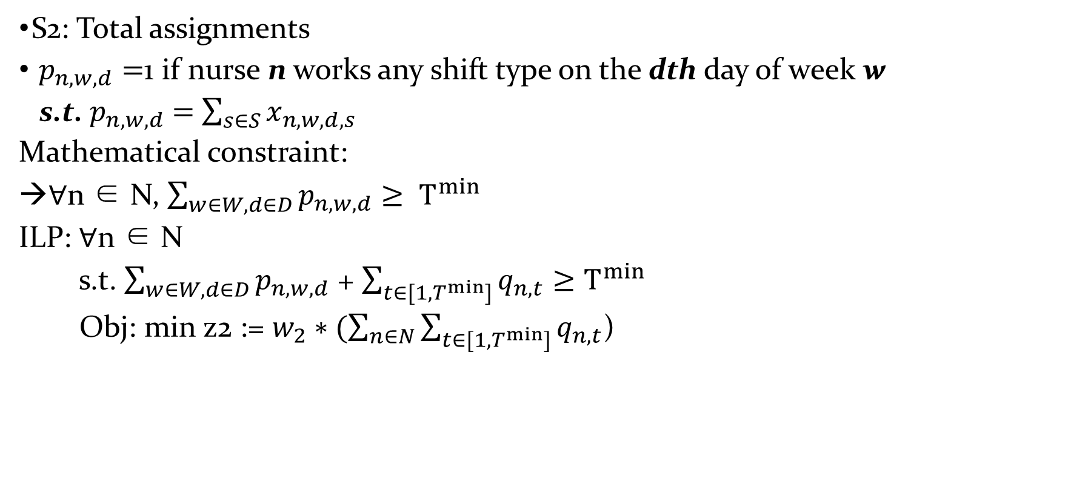
Soft (S) constraints types:
S2: Total assignments
$p_{n,w,d}=$1 if nurse n works any shift type on the dth day of week w
s.t. $p_{n,w,d}$ $=$ $\sum_{s∈S}{x_{n,w,d,s}}$
Mathematical constraint:
→∀n ∈ N, $\sum_{w∈W,d∈D}{p_{n,w,d}}≥ T^{min}$
ILP: ∀n ∈ N
s.t. $\sum_{w∈W,d∈D}{p_{n,w,d}}$ + $\sum_{t∈{[1,T}^{min}]}{q_{n,t}}≥T^{min}$
Obj: min z2 := $w_{2}∗(\sum_{n∈N}{\sum_{t∈{[1,T}^{min}]}{q_{n,t}}}$)

Slide 71
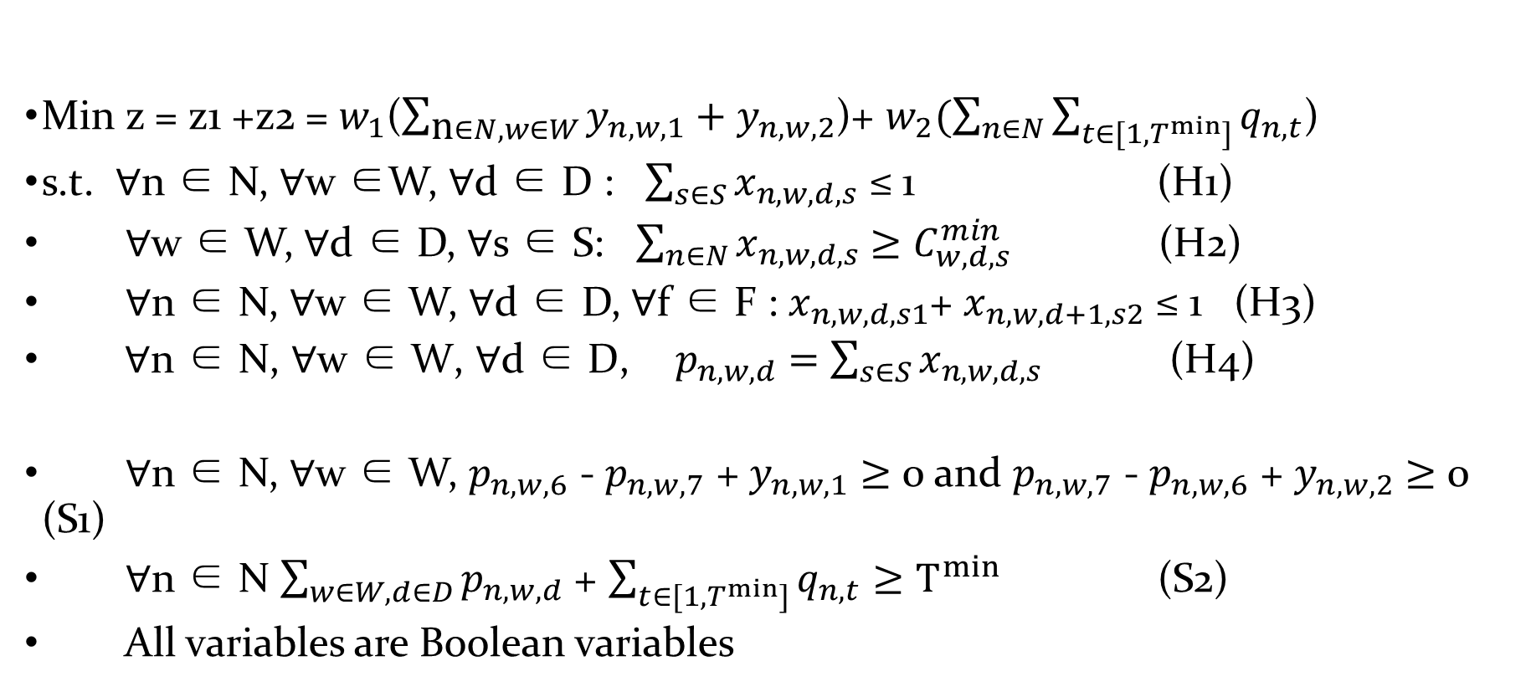
Overall (0-1 ILP):
Min z = z1 +z2 = $w_{1}$($\sum_{\text{n}∈N, w∈W}{y_{n,w,1}}+y_{n,w,2}$)+ $w_{2}(\sum_{n∈N}{\sum_{t∈{[1,T}^{min}]}{q_{n,t}}}$)
s.t. ∀n ∈ N, ∀w ∈W, ∀d ∈ D : $\sum_{s∈S}{x_{n,w,d,s}}$ ≤ 1 (H1)
∀w ∈ W, ∀d ∈ D, ∀s ∈ S: $\sum_{n∈N}{x_{n,w,d,s}}$ $≥$ $C_{w,d,s}^{min}$ (H2)
∀n ∈ N, ∀w ∈ W, ∀d ∈ D, ∀f ∈ F : $x_{n,w,d,s1}$+ $x_{n,w,d+1,s2}$ ≤ 1 (H3)
${ \text{∀}\text{n} \text{∈ }\text{N}\text{, }\text{∀}\text{w} \text{∈ }\text{W}\text{, }\text{∀}\text{d} \text{∈ }\text{D}\text{,} p}_{n,w,d}$ $=$ $\sum_{s∈S}{x_{n,w,d,s}}$ (H4)
∀n ∈ N, ∀w ∈ W, $p_{n,w,6}$ - $p_{n,w,7}$ + $y_{n,w,1}$ $≥$ 0 and $p_{n,w,7}$ - $p_{n,w,6}$ + $y_{n,w,2}$ $≥$ 0 (S1)
∀n ∈ N $\sum_{w∈W,d∈D}{p_{n,w,d}}$ + $\sum_{t∈{[1,T}^{min}]}{q_{n,t}}≥T^{min}$ (S2)
All variables are Boolean variables

Slide 72
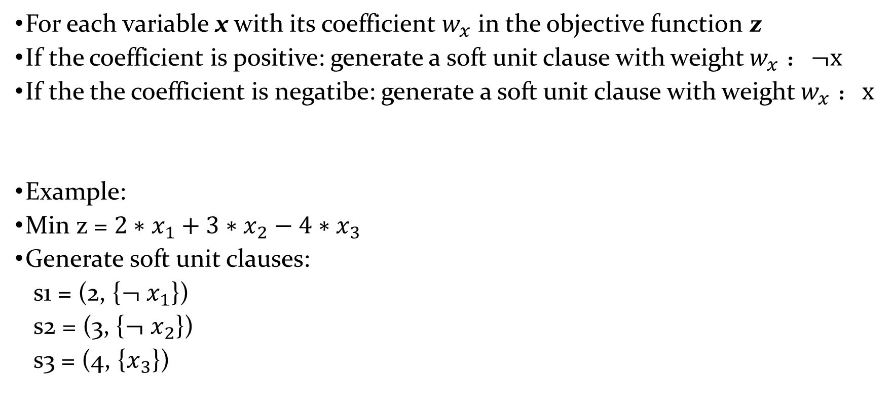
0-1 ILP into Partial MaxSAT: objective function
For each variable x with its coefficient $w_{x}$ in the objective function z
If the coefficient is positive: generate a soft unit clause with weight $w_{x}$ ：$¬x$
If the the coefficient is negatibe: generate a soft unit clause with weight $w_{x}$ ：$x$
Example:
Min z = ${2∗x}_{1}+{3∗x}_{2}−4∗x_{3}$
Generate soft unit clauses:
s1 = (2, {$¬$ $x_{1}$})
s2 = (3, {$¬$ $x_{2}$})
s3 = (4, {$x_{3}$})

Slide 73
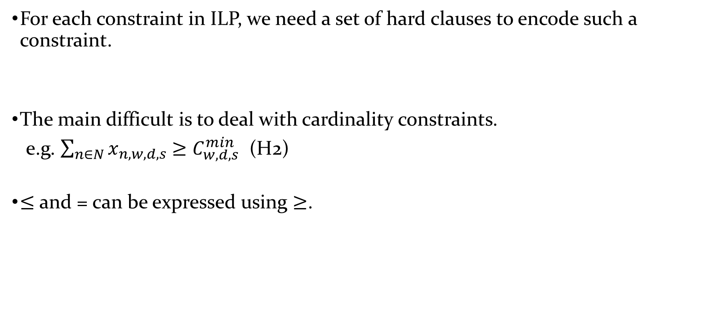
0-1 ILP into Partial MaxSAT: constraints
For each constraint in ILP, we need a set of hard clauses to encode such a constraint.
The main difficult is to deal with cardinality constraints.
e.g. $\sum_{n∈N}{x_{n,w,d,s}}$ $≥$ $C_{w,d,s}^{min}$ (H2)
$≤$ and = can be expressed using $≥$.

Slide 74
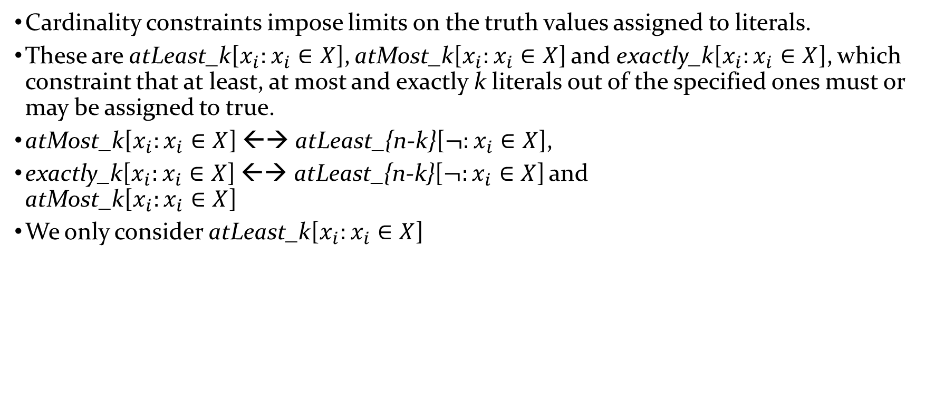
Cardinality constraints
Cardinality constraints impose limits on the truth values assigned to literals.
These are atLeast_k[$x_{i}:x_{i}∈X$], atMost_k[$x_{i}:x_{i}∈X$] and exactly_k[$x_{i}:x_{i}∈X$], which constraint that at least, at most and exactly k literals out of the specified ones must or may be assigned to true.
atMost_k[$x_{i}:x_{i}∈X$] ←→ atLeast_{n-k}[$¬:x_{i}∈X$],
exactly_k[$x_{i}:x_{i}∈X$] ←→ atLeast_{n-k}[$¬:x_{i}∈X$] and atMost_k[$x_{i}:x_{i}∈X$]
We only consider atLeast_k[$x_{i}:x_{i}∈X$]

Slide 75
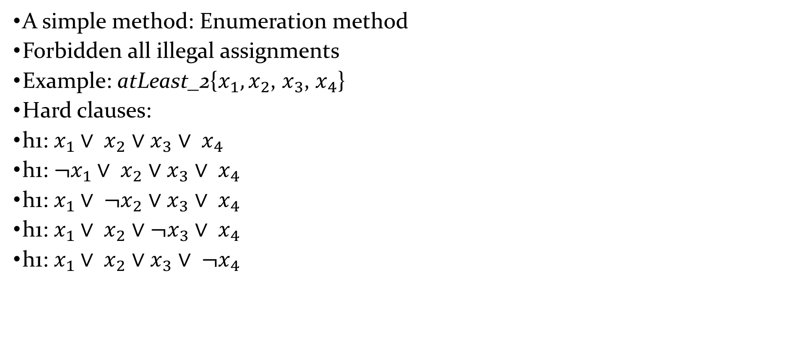
Cardinality Constraints Encoding
A simple method: Enumeration method
Forbidden all illegal assignments
Example: atLeast_2{$x_{1},x_{2}$, $x_{3}$, $x_{4}$}
Hard clauses:
h1: $x_{1}∨ x_{2}$ $∨$ $x_{3}$ $∨ x_{4}$
h1: ${¬x}_{1}∨ x_{2}$ $∨$ $x_{3}$ $∨ x_{4}$
h1: $x_{1}∨ {¬x}_{2}$ $∨$ $x_{3}$ $∨ x_{4}$
h1: $x_{1}∨ x_{2}$ $∨$ ${¬x}_{3}$ $∨ x_{4}$
h1: $x_{1}∨ x_{2}$ $∨$ $x_{3}$ $∨ {¬x}_{4}$

Slide 76
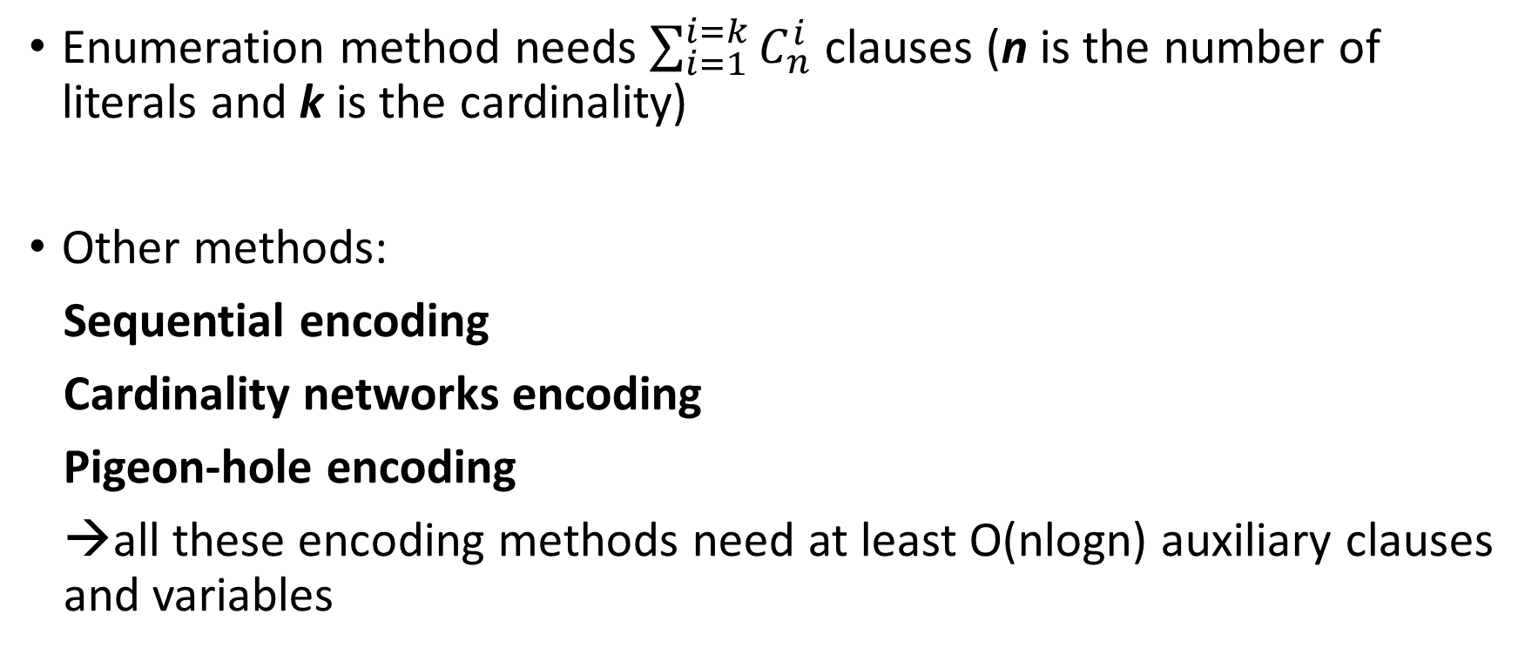
Cardinality Constraints Encoding
Enumeration method needs $\sum_{i=1}^{i=k}{C_{n}^{i}}$ clauses (n is the number of literals and k is the cardinality)
Other methods:
Sequential encoding
Cardinality networks encoding
Pigeon-hole encoding
→all these encoding methods need at least O(nlogn) auxiliary clauses and variables

